Slide 1

Design Patterns
Part 3
Lucky Nkosi

Slide 2
Behavioral Design Patterns
Chain of Responsibility
Command
Iterator
Mediator
Memento
Observer
State
Strategy
Template Method
Visitor

Slide 3

Quite a list to get through

Slide 4


Slide 5
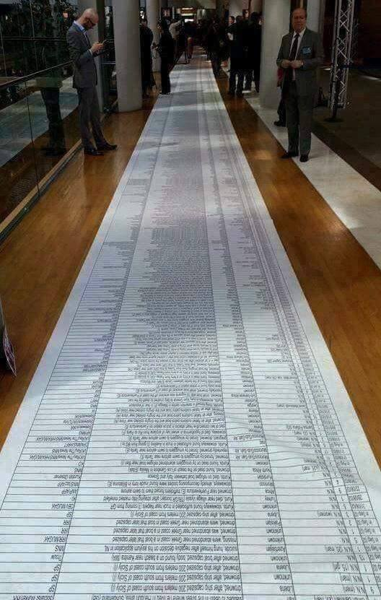
Pattern after pattern

Slide 6


Slide 7
Behavioral Design Patterns
Behavioral design patterns deal with communication between objects
You can control how and when messages are passed between senders and receivers
You can control who can communicate with who You can package complex requests into objects
You can control how a system chooses between algorithms

Slide 8

Chain of Responsibility

Slide 9
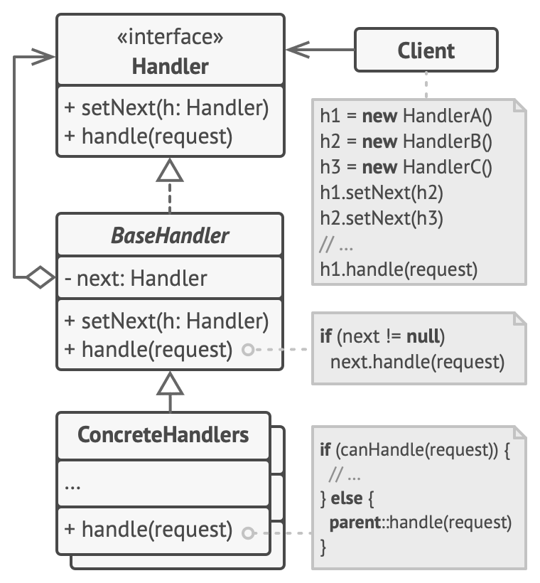
Chain of Responsibility
●
The chain of responsibility pattern allows for a series of handler objects to be dynamically linked in a chain.
Requests can be passed along the chain, and each handler object decides
whether or not to process the request whether or not to pass the request along the chain
●
●

Slide 10
Chain of Responsibility
●
Handler – defines an interface for handling requests and specifies a compositional relationship with a Handler, via a successor attribute
BaseHandler – optional class for defining boilerplate Handler functionality ConcreteHandler – implements the
Handler interface, can forward requests to its successor
Client – initiates the request to a ConcreteHandler on the chain
●
●
●

Slide 11
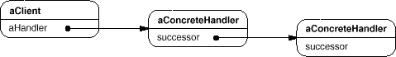
Chain of Responsibility
●
Instantiated structure of chain of responsibility

Slide 12
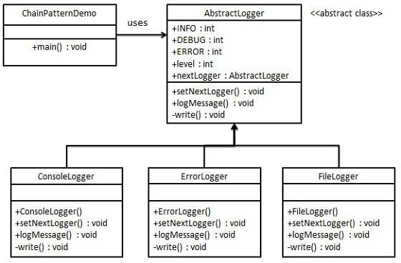
Chain of Responsibility
●
Example: chain of loggers
●
Only log a message to the correct output (console, error stream or file)
Message is passed along chain until the right handler can log it
Client doesn’t have to know which logger ends up doing the processing
●
●

Slide 13
Chain of Responsibility
●
Chain of Responsibility vs Decorator
●
Both have a similar structure, however:
●
Decorators extend an object’s functionalities while still forcing it to conform to a base interface
Chain of Responsibility must conform to handler interface, but can execute any arbitrary functionality as needed
Decorators cannot break the flow of a request
Chain of Responsibility can break the flow of a request at any point
●
●
●
●
Conceptually, Decorator adds functionality while Chain of Responsibility passes messages along

Slide 14
Chain of Responsibility
●
Use Chain of Responsibility when:
●
multiple objects may handle a request and the right object isn’t known by the client
you want to pass a request to one of multiple objects without having to specify which object should handle the request
the set of objects that can handle the request should be specified dynamically
●
●

Slide 15
Chain of Responsibility
●
Pros:
You can control the order of request handling
You can decouple initiating a request from handling the request
●
●
●
Single Responsibility Principle
●
You can introduce new handlers without breaking existing code
●
Open/Closed Principle
●
Cons:
●
Can be tricky to debug sometimes

Slide 16

Command Pattern

Slide 17
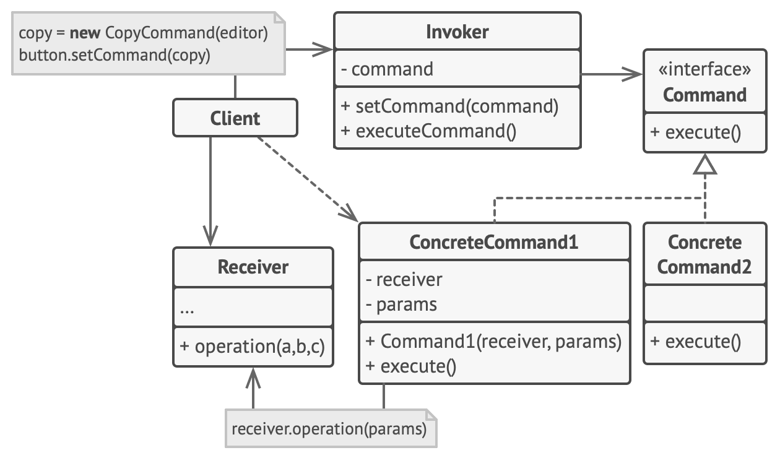
Command
●
The command pattern, also called the action or transaction pattern, encapsulates a request into an object, allowing for requests to be
passed as method arguments delayed or queued
undone at a later point
●
●
●

Slide 18
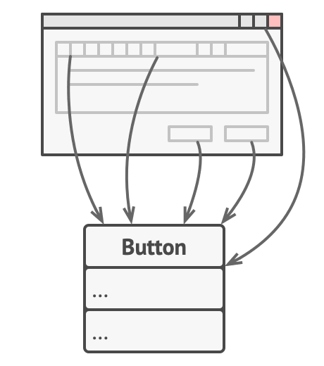
Command
●
Motivation: you are creating a text editor application
●
You create a Button class for buttons that perform various different tasks and can be located in the tool bar or in a a variety of dialogs

Slide 19
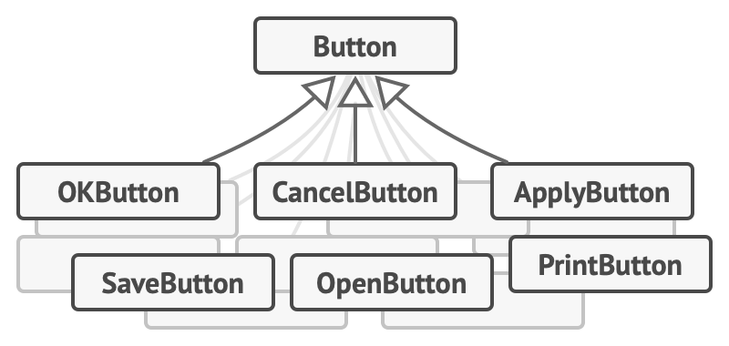
Command
●
Motivation: each button has a different function, with different code to be executed upon being clicked
●
One possible solution may be to subclass Button for each type of button
●
But you may end up with too many subclasses, all dependent on Button

Slide 20
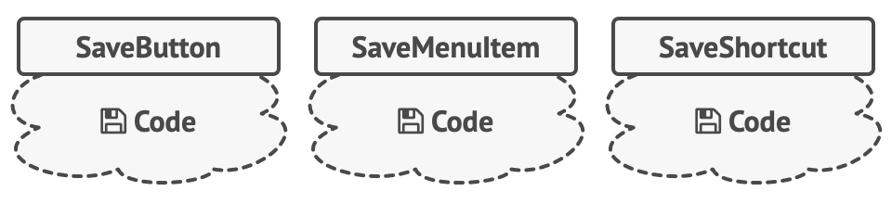
Command
●
Motivation: additionally, multiple different classes may rely on the same code
●
e.g. a Save button in the toolbar or in a dialog, or a save shortcut (e.g. ctrl + s) may all execute the same code
Subclassing approach forces you to repeat code
●

Slide 21
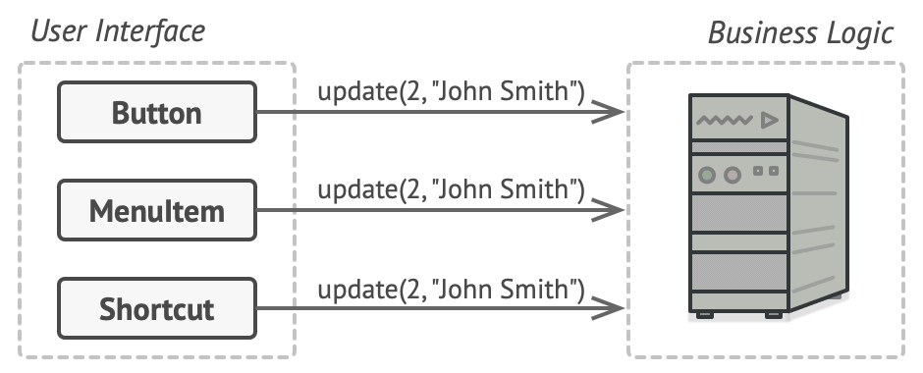
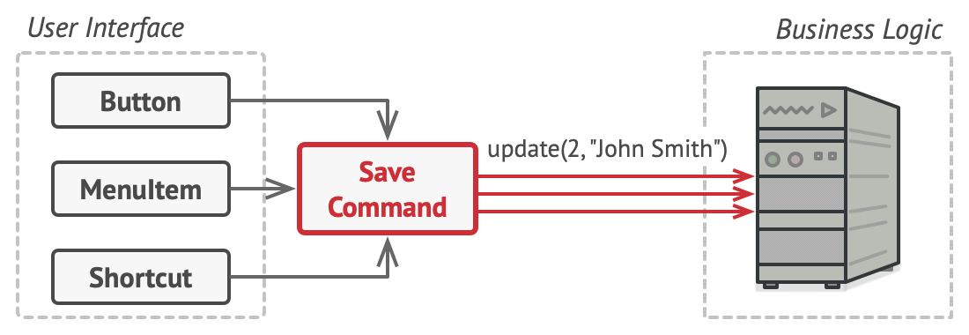
Command
●
Motivation: instead of repeating each piece of code for each variation of the button/request, rather encapsulate the request itself as an object
Subclassing approach
Command pattern

Slide 22
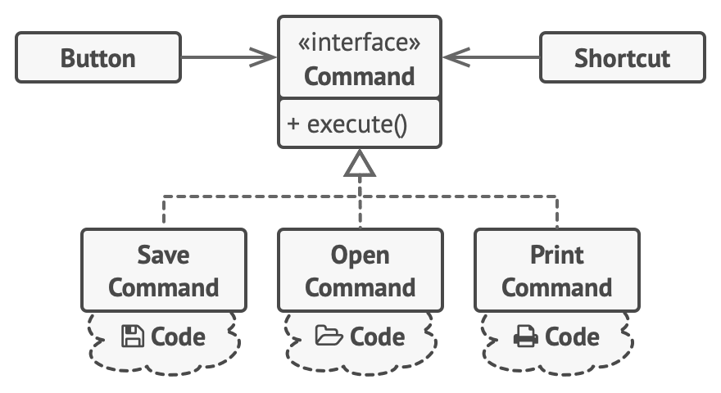
Command
●
Motivation: user interface elements like buttons and shortcuts can now delegate responsibility to command objects

Slide 23
Command
●
Command – defines an interface for a request
ConcreteCommand – binds a Receiver to an action, implements Execute() by calling an action on a Receiver
Receiver – knows how to perform an action associated with a request
Client – creates a ConcreteCommand and binds it to a Receiver
Invoker – asks the Command to carry out a request
●
●
●
●

Slide 24
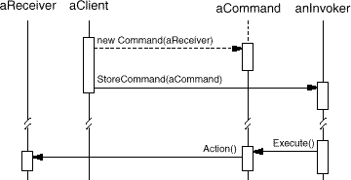
Command
●
Example sequence diagram

Slide 25
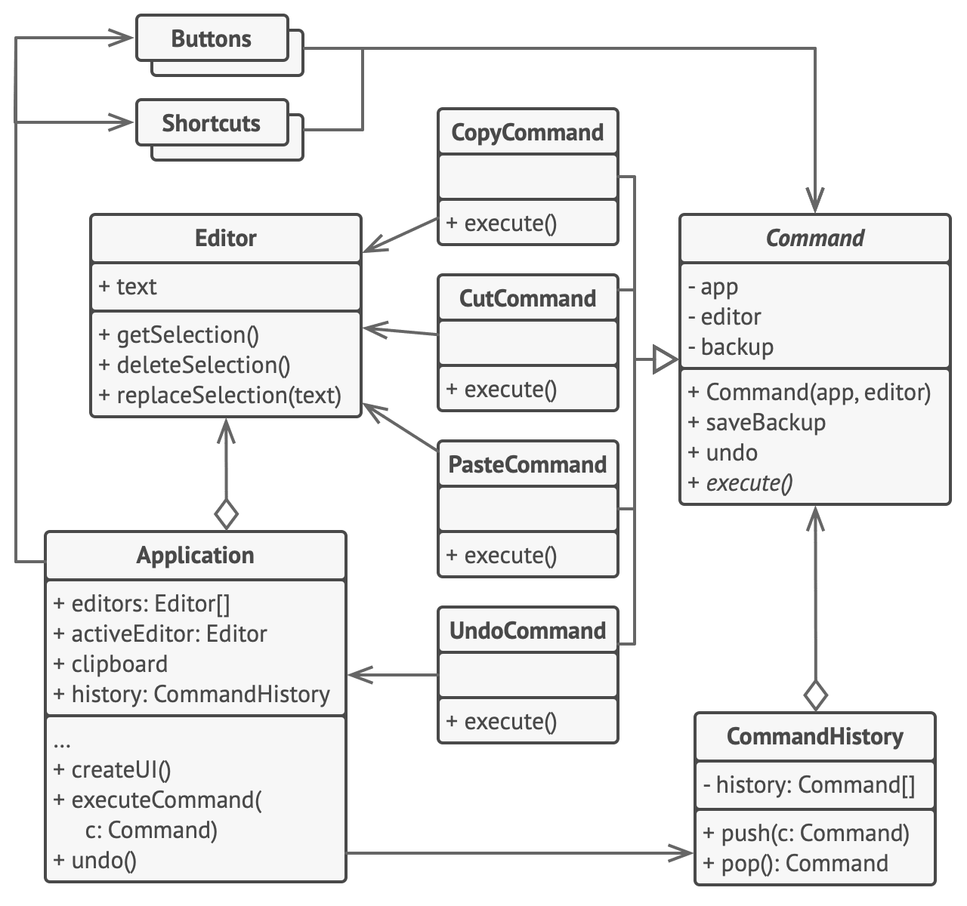
Command
●
Example: text editor app
Can copy, cut, paste Also keeps a stack to
allow for undo commands
●
●
Editor = Receiver Application = Client Buttons/Shortcuts = Invoker
●
●
●

Slide 26
Command
●
Use command when you want to :
parameterise objects with actions
specify, queue, and execute requests at different times support undoing an operation
support logging changes to allow for restoration in the event of a crash
●
●
●
●

Slide 27
Command
●
Pros:
●
Decouples invoking an operation from performing an operation
●
Single Responsibility Principle
●
New commands can be added without breaking existing functionality
●
Open/Closed Principle
Undoing/Redoing actions can be implemented Actions can be deferred/queued
●
●
●
Cons:
●
Adding an extra layer of communication between invokers and receivers can add additional complexity

Slide 28

IteratoRPattern

Slide 29
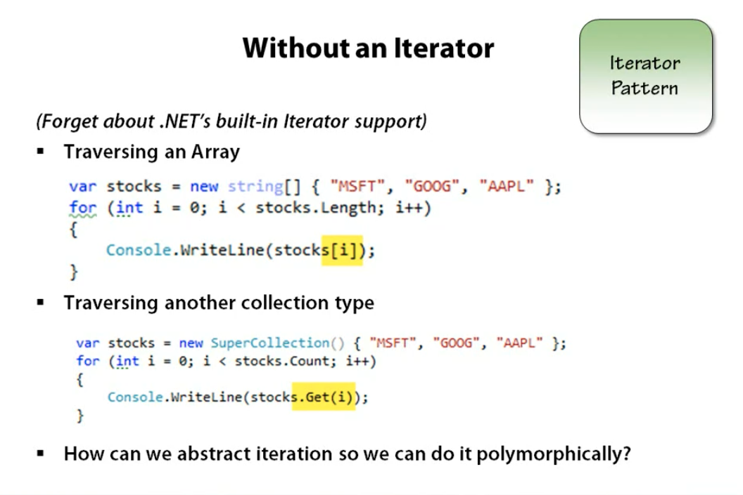
Notes:
Considering that we can traverse collection types differently in some languages, how do we extract that out and do it consistently?

Slide 30
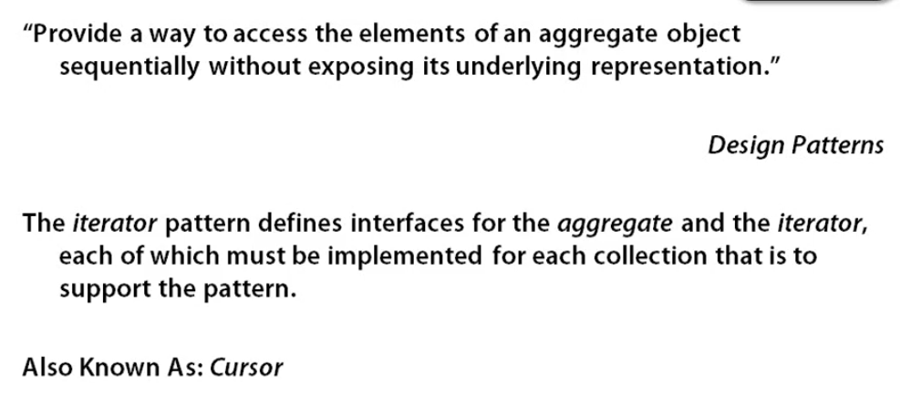
Intent

Slide 31
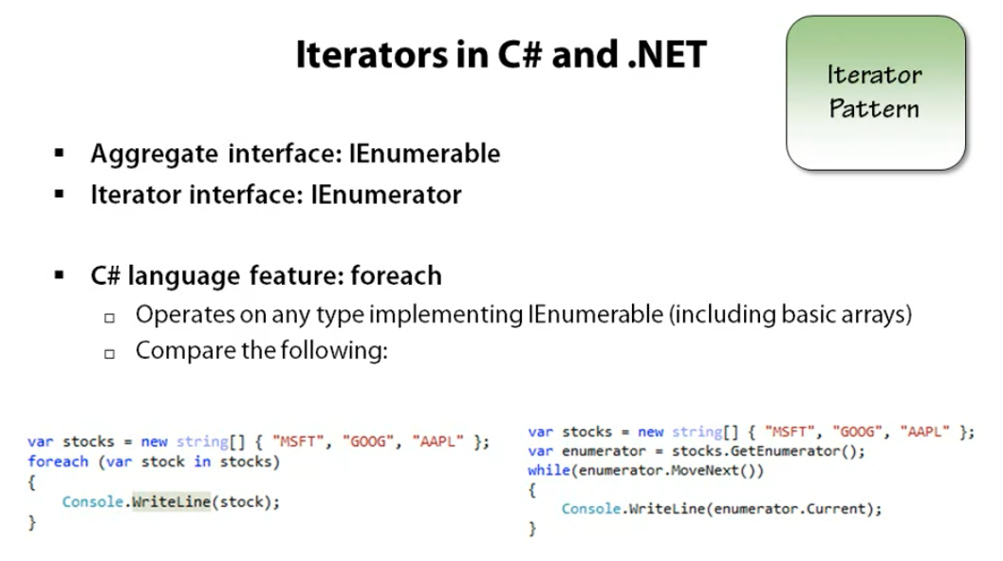
Notes:
We can write foreach because we’re using arrays but it might not work for other collections. This requires our client code ie(wherever we’re writing this) to be responsible for how we traverse a collection. Alternatively, if we use the iterator pattern, we can abstract that away and use Enumerator. That way, whether stocks is a dictionary, or array, or anything else, we’ll be able to traverse it and the classes we create become responsible for how they are internaly traversed.

Slide 32
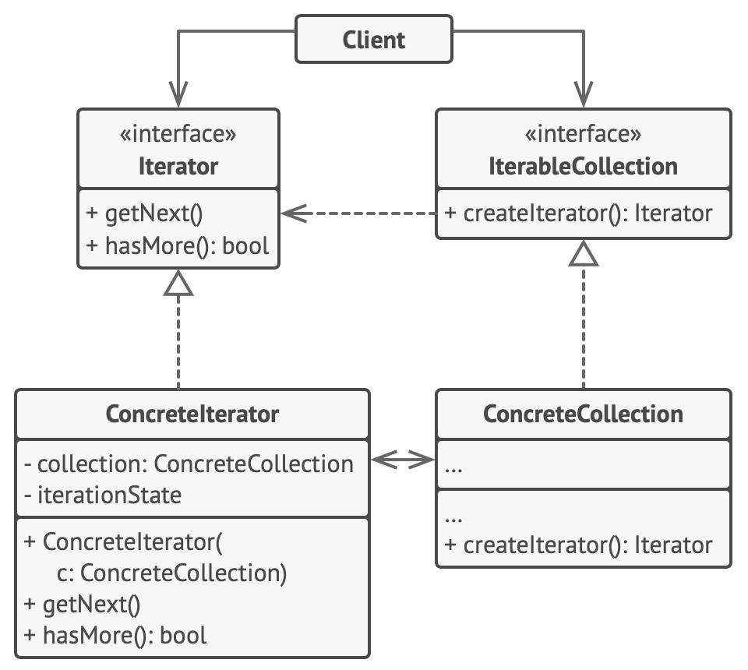
Iterator
●
The iterator pattern, also called the cursor pattern, provides a way of traversing a container and accessing its elements without exposing its underlying elements
●
Allows for algorithms (e.g. SearchForElement) to be decoupled from containers (e.g. lists, linked lists, trees, stacks, etc.)

Slide 33
Iterator
●
Iterator – defines an interface for accessing and traversing elements
ConcreteIterator – implements Iterator, keeps track of current position in traversal of Aggregate
Aggregate a.k.a. IterableCollection – defines an interface for creating an Iterator
ConcreteAggregate a.k.a. ConcreteCollection – implements Aggregate, creates the correct ConcreteIterator
●
●
●

Slide 34
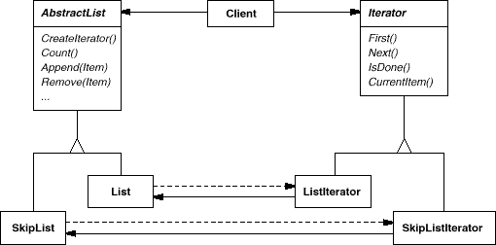
Iterator
●
Example: traversing different kinds of data structures
●
Note: SkipList is a type of probabilistic data structure
Note: this particular diagram uses older OMT syntax, not UML

Slide 35
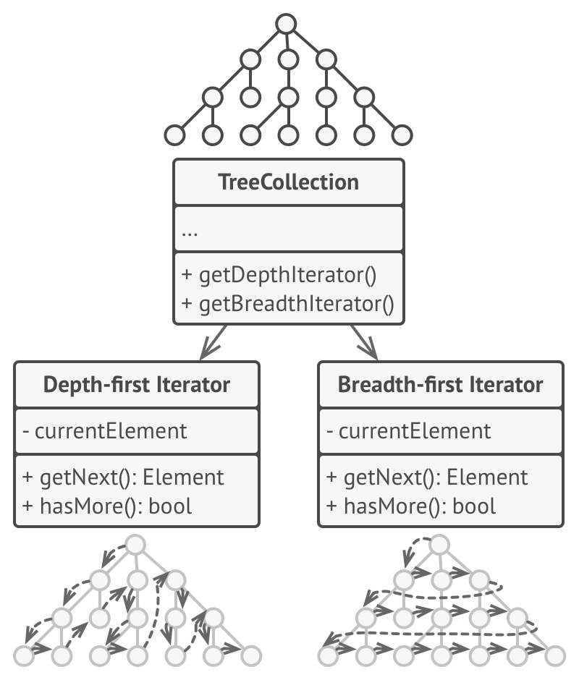
Iterator
●
Example: the iterator pattern can also support different types of traversal of the same kind of data structure
●
e.g. Depth-first vs Breadth-first

Slide 36
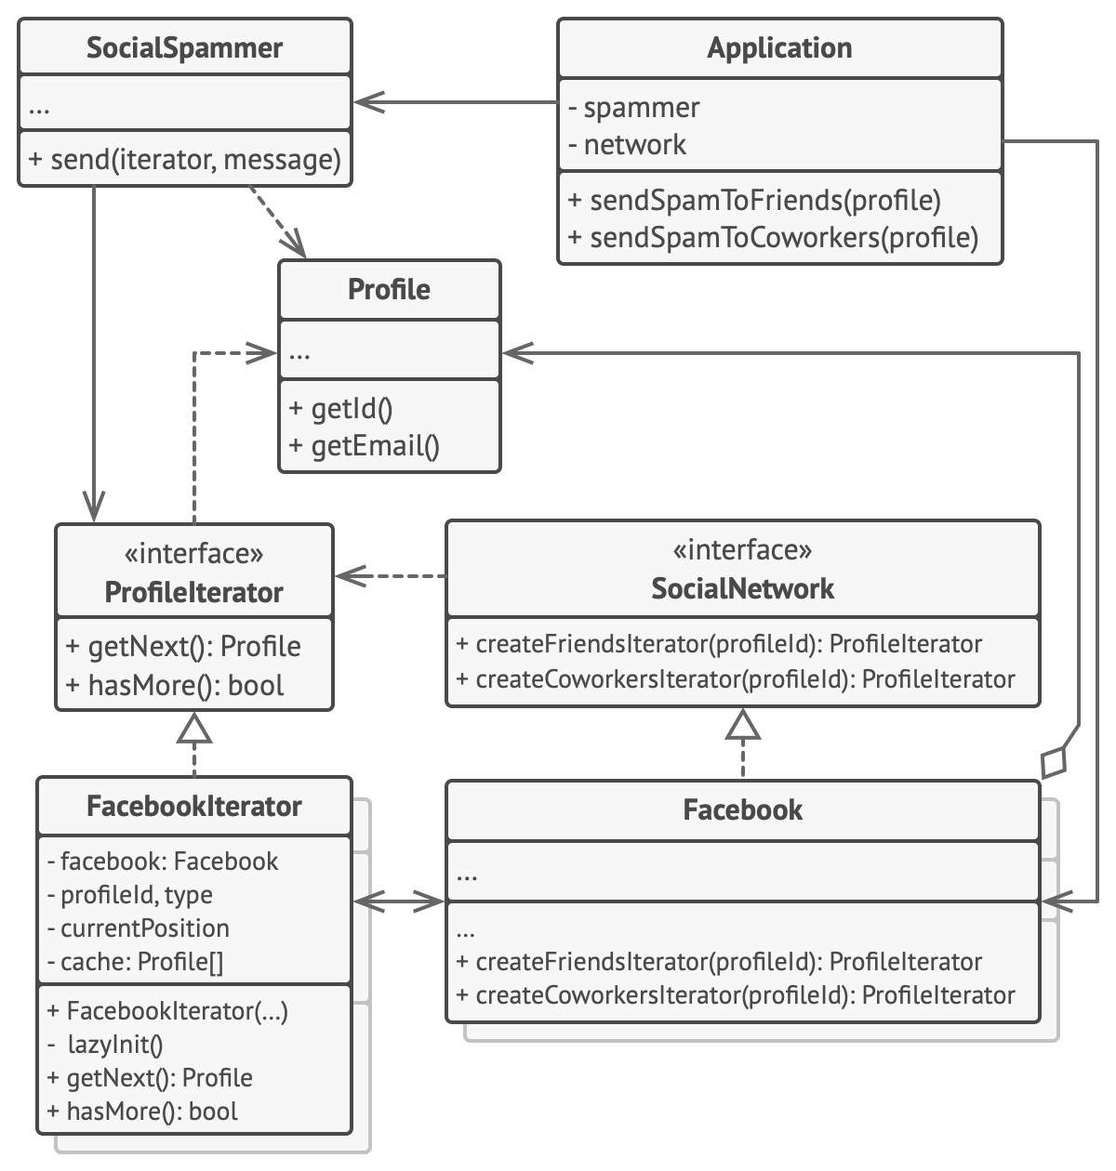
Iterator
●
Example: sending spam to friends/coworkers of an individual by traversing Facebook’s social graph

Slide 37
Iterator
●
Use iterator:
●
to access an aggregate object's contents without exposing its internal representation
to support multiple traversals of aggregate objects
to provide a uniform interface for traversing different aggregate structures
●
●
●
polymorphic iteration

Slide 38
Iterator
●
Pros:
●
Client code doesn’t have to care about how to traverse a collection
●
Single Responsibility Principle
●
New types of collections/traversals can be added without breaking existing code
●
Open/Closed Principle
The same object can be iterated over in parallel by using different iterators Traversal can be delayed and resumed at a later point
●
●
●
Cons:
Often overkill if only a few types of collections are used
Adding an iterator may be less efficient with some data structures
●
●

Slide 39

Mediator Pattern

Slide 40

Notes:
Let’s say we have multiple planes in the airspace. Each movement the plane makes, we need to consider the impact to other planes. Since they all have different safe following distances, they will have to know about each other and notify each other. The code logic becomes too much so we can introduce a central mediator to coordinate all of this.

Slide 41
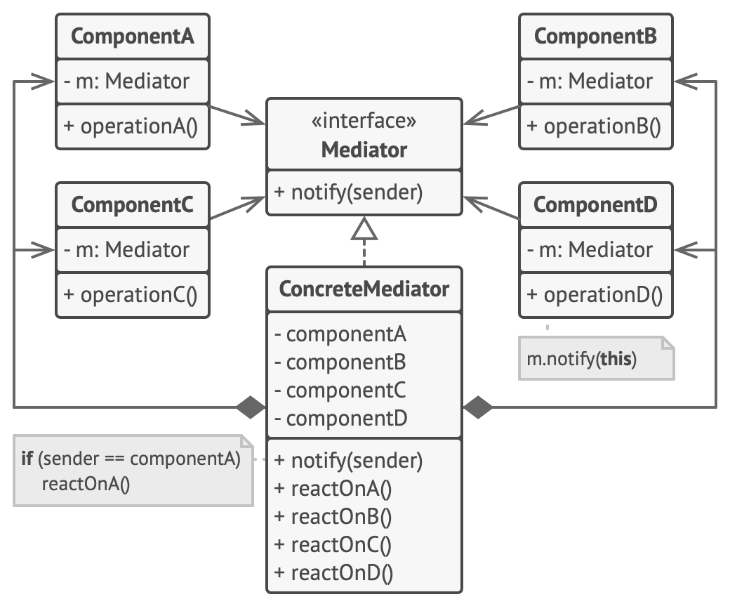
Mediator
●
The mediator pattern encapsulates how a set of objects interact, forcing objects to communicate via a mediator object

Slide 42
Mediator
●
Mediator – defines the interface for communication between Colleagues
ConcreteMediator – implements the Mediator
●
Knows, maintains and coordinates Components
Component – each Component knows its Mediator and communicates with it instead of communicating with other Component directly
●
●

Slide 43
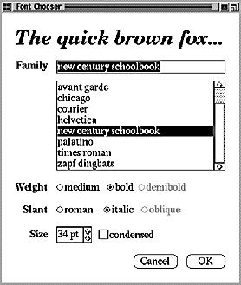
Mediator
●
Example: dynamic font selection UI
●
Weight and Slant options dynamically available depending on selected font
Having the dropdown menu communicate directly with the individual checkboxes may introduce many extra dependencies
●

Slide 44
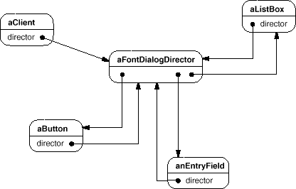
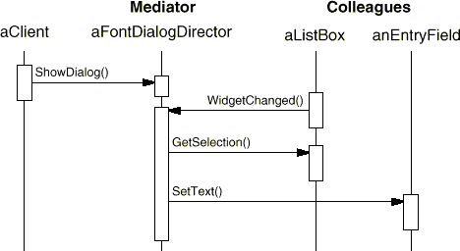
Mediator
●
Example: dynamic font selection UI
●
Instead, each element in the UI can communicate with a single mediator
Mediator decides how to adjust the UI based on changes to its elements
●

Slide 45
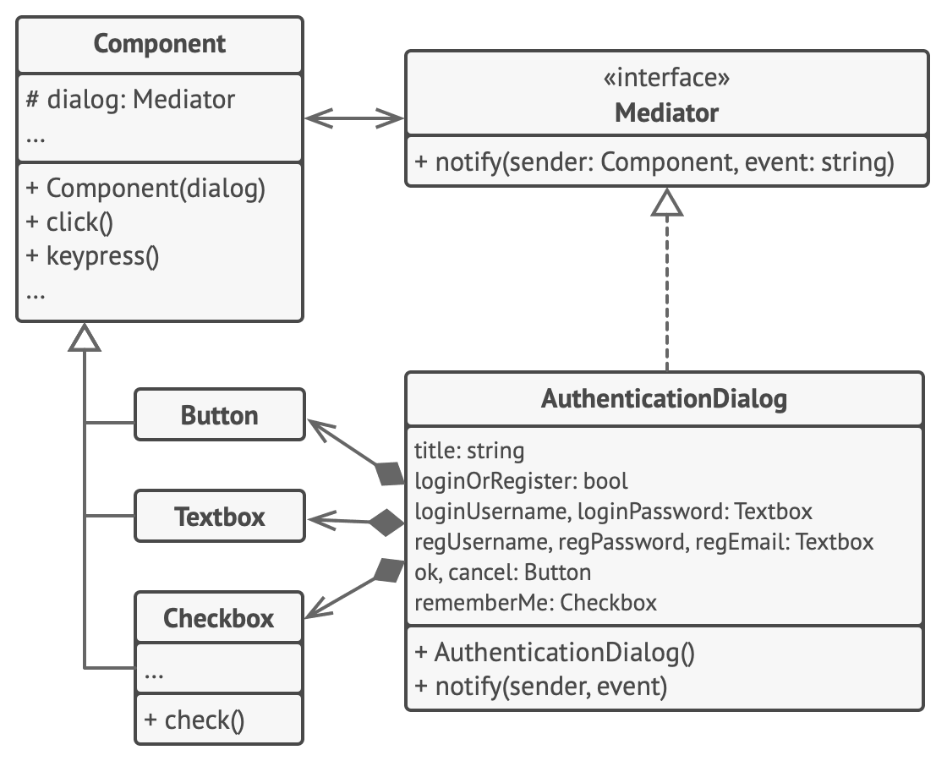
Mediator
●
Example: dynamic UI

Slide 46
Mediator
●
Use mediator when:
a set of objects communicate with each other in a defined but complex way reusing an object is difficult because it refers to and communicates with many other objects
a behavior that's distributed between several classes should be customisable without a lot of subclassing
●
●
●

Slide 47
Mediator
●
Pros:
●
Communications between objects can be delegated to a separate object, making them easier to understand and maintain
●
Single Responsibility Principle
●
New mediators can be introduced without having to change the colleagues
●
Open/Closed Principle
Reduced coupling between different classes Individual classes can be reused more easily
●
●
●
Cons:
●
A mediator can evolve over time into a god object

Slide 49
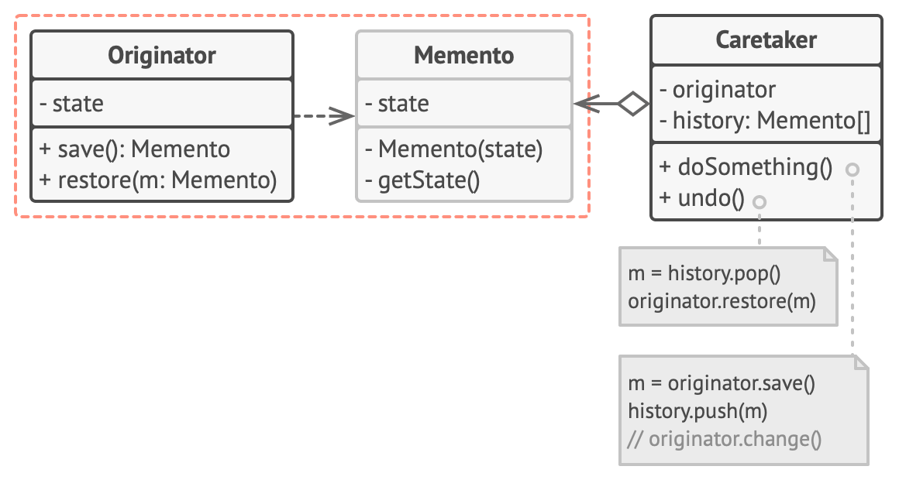
Memento
●
The memento pattern, also called the token or snapshot pattern, allows the state of an object to be saved without revealing the details of its implementation

Slide 50
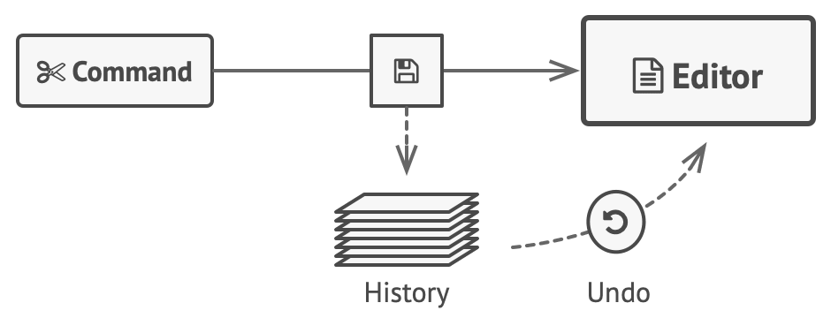
Memento
●
Motivation: consider a text editing program in which the user is able to undo operations
●
In order to do this, the program must store the states of all objects at every operation

Slide 51
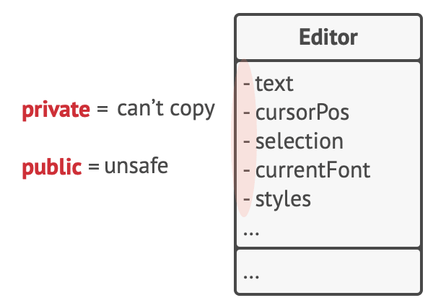
Memento
●
Motivation: if we copy every object’s attributes directly, then we violate the object’s encapsulation (i.e. we cannot copy private variables)

Slide 52
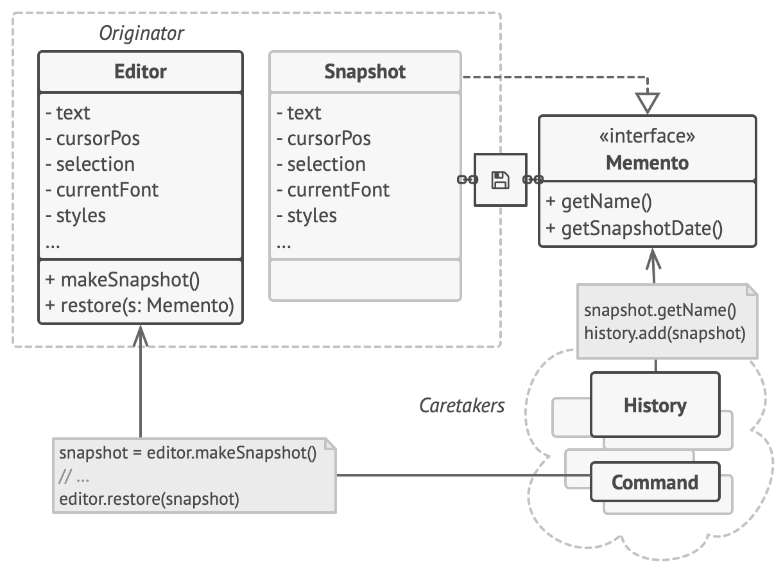
Memento
●
Motivation: instead, delegate the responsibility of creating the state snapshot to the originator of the state, and then store the snapshot in a memento object
●
A caretaker object can store multiple memento objects, but cannot access their internal state

Slide 53
Memento
●
Memento - stores internal state of the Originator object
●
Has a limited interface to be used by other classes (e.g. Caretaker), and a full interface used to restore state by the Originator
●
Can be implemented using a friend class or similar idiom, or by delegating the restoration responsibility to the Memento

Slide 54
Memento
●
Originator – creates a Memento containing a snapshot of internal state and can use the Memento to restore its state
Caretaker – responsible for storing Memento objects
●
●
Cannot access the Memento’s contents

Slide 55
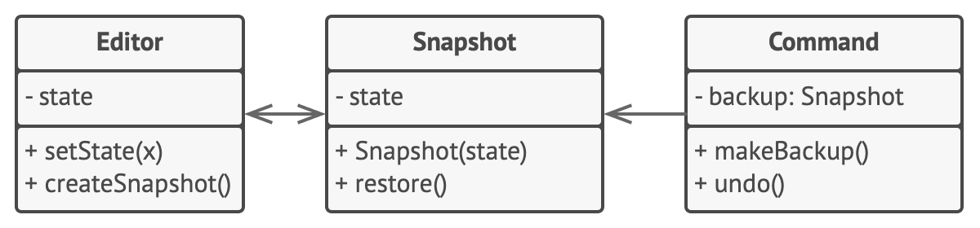
Memento
●
Example - editor

Slide 56
Memento
●
Use memento when:
a snapshot of an object’s state needs to be saved for later restoration, and a direct interface to obtaining the state would expose implementation details and break the object's encapsulation
●
●

Slide 57
Memento
Pros:
You can produce snapshots of the object’s state without violating its encapsulation
You can simplify the originator’s code by letting the caretaker maintain the history of the originator’s state
Cons:
Too many mementos may affect performance and RAM usage
Caretakers should track the originator’s lifecycle to be able to destroy obsolete mementos
Most dynamic programming languages, such as PHP, Python and JavaScript, can’t guarantee that the state within the memento stays untouched

Slide 58

Observer Pattern

Slide 59
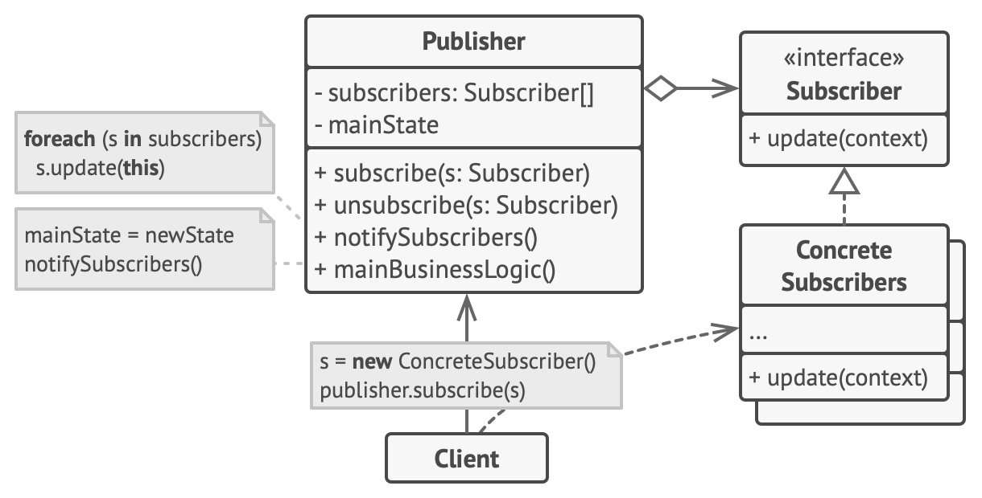
Observer
●
The observer pattern, also called the publisher- subscriber (pub-sub), dependents or listener pattern, allows a set of observers to be notified of any relevant changes to a subject
●
Very useful in implementing event- driven architectures

Slide 60
Observer
●
Subject/Publisher – knows its Subscribers. Defines an interface for attaching/detaching Subscribers
Observer/Subscriber – defines an interface for objects that should be notified of changes to a Publisher
ConcretePublishers & ConcreteSubscribers
●
●

Slide 61
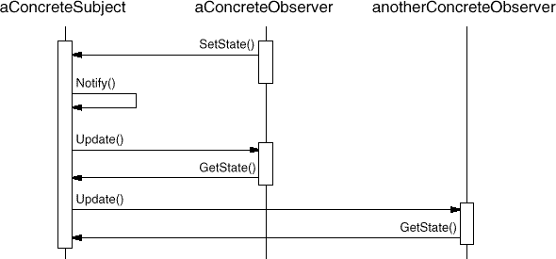
Observer
●
Example sequence of communications

Slide 62
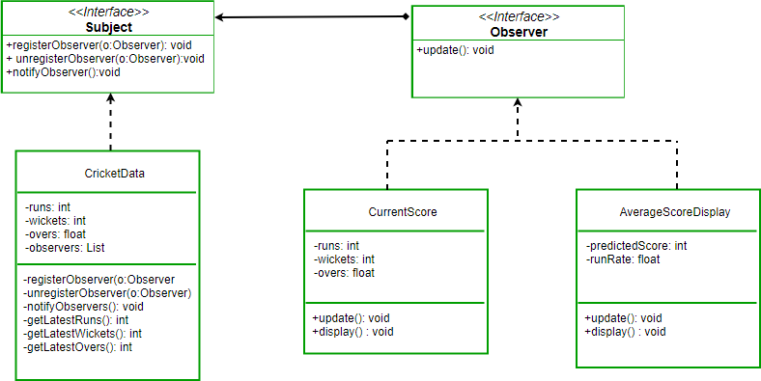
Observer
●
Example: cricket score app

Slide 63
Observer
●
Use observer when:
●
an abstraction has two aspects, one dependent on the other
Separating these aspects allows them to vary and be reused independently
a change to one object requires changing others, and you don't know how many objects need to be changed
an object should be able to notify other objects without making assumptions about who these objects are
●
●
●

Slide 64
Observer
●
Pros:
●
New subjects and observers can be added without breaking existing code
●
Open/Closed Principle
●
You can establish relations between objects at runtime
●
Cons:
Can potentially add more complexity to a system
The order in which observers are notified is not predictable
●
●

Slide 65

State Pattern

Slide 66
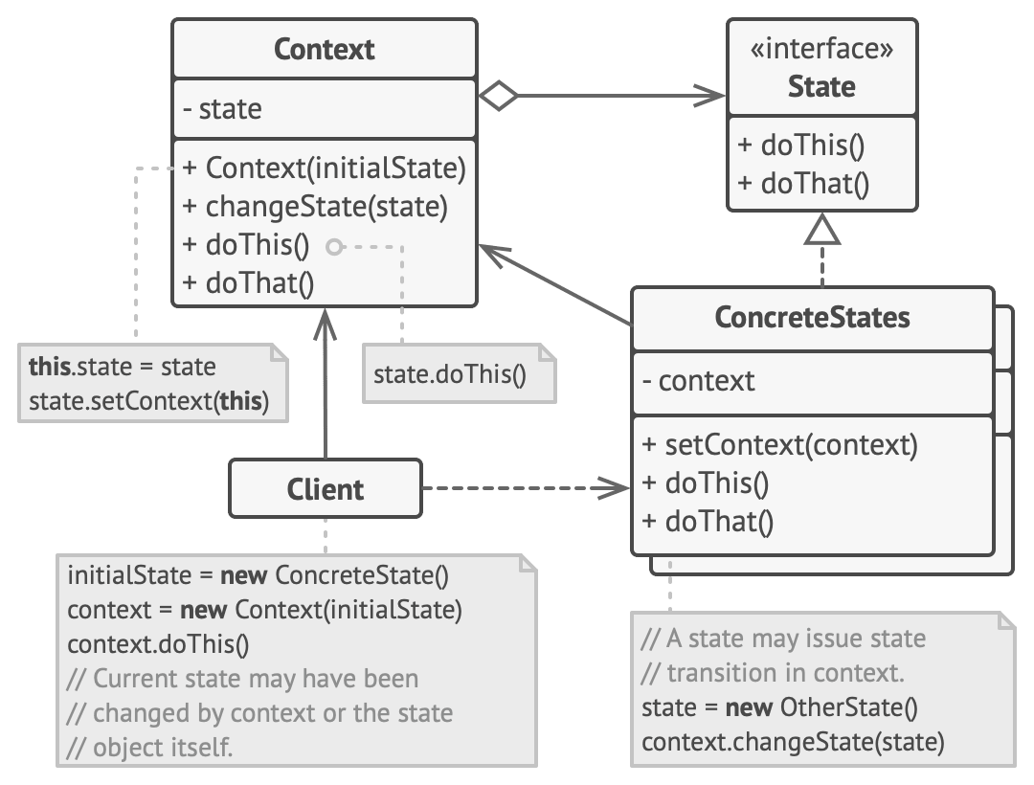
State
●
The state pattern, also called the objects for states pattern, allows an object to alter its behavior when its internal state changes

Slide 67
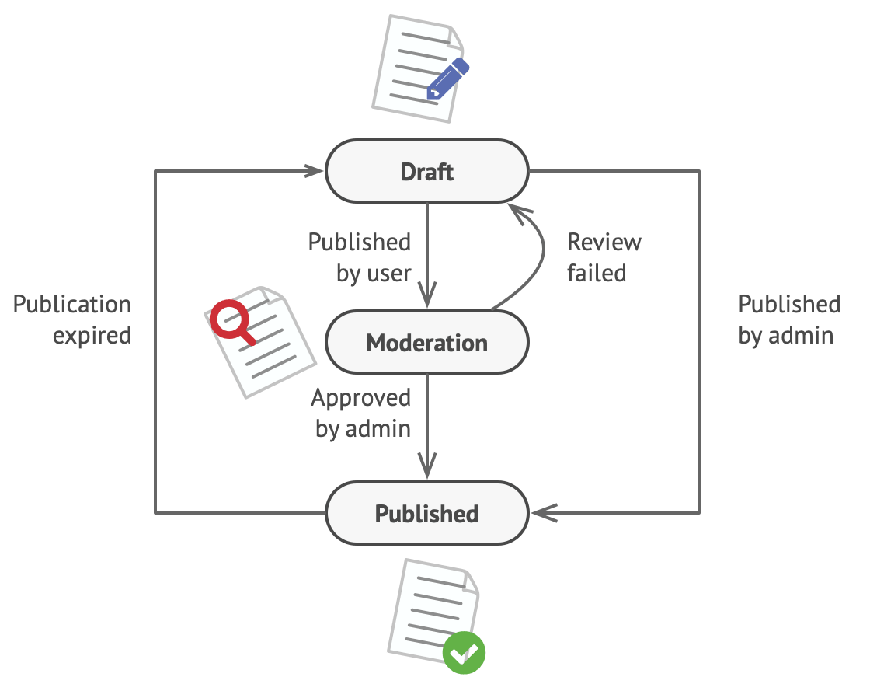
State
●
Motivation: suppose we have a Document class with three possible states
●
Draft – the document is currently being worked on by a user
Moderation – when published, the document moves to a moderation state, to be approved or rejected by admins
Published – when approved by admins, the document is available for all to see
●
●
●
This is a finite state machine

Slide 68
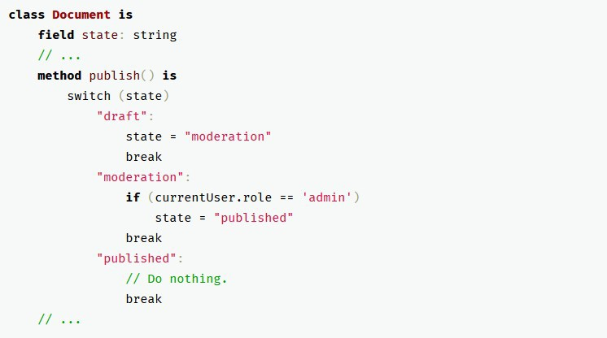
State
●
Motivation: state and transition logic typically handled using conditional statements
●
Many states can quickly result in complex conditional logic, which is difficult to understand, maintain and modify

Slide 69
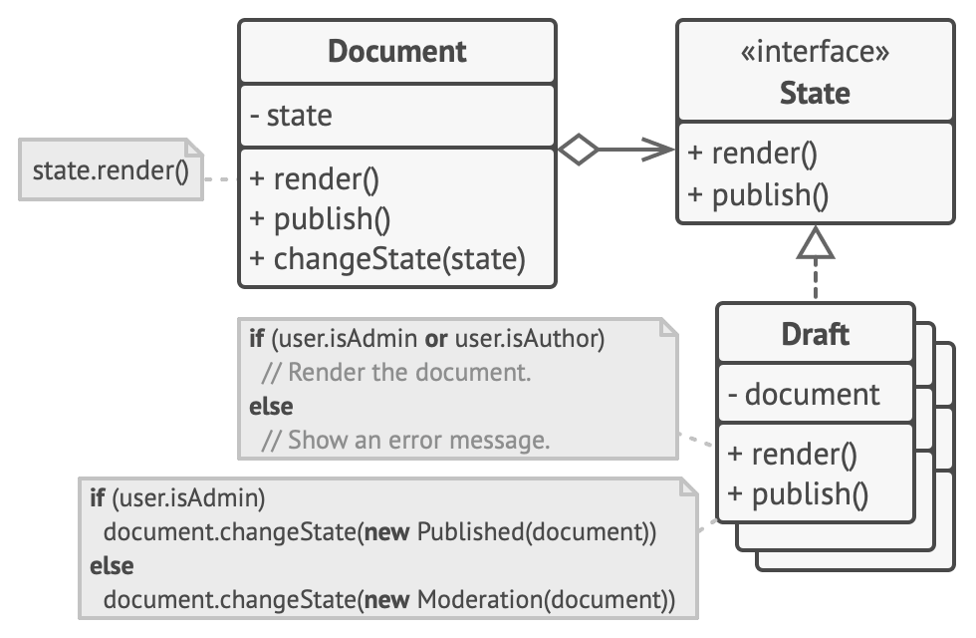
State
●
Motivation: instead, have each state implement a common interface and delegate the state-specific functionality to each subclass
●
When transitioning between states, simply replace the active state object with a different state subclass

Slide 70
State
●
Context – maintains an instance of a State subclass that represents the current state
State – defines the interface for encapsulating the behaviour of a state of the Context
ConcreteState – implements the State interface with behaviour specific to the state it represents
●
●

Slide 71
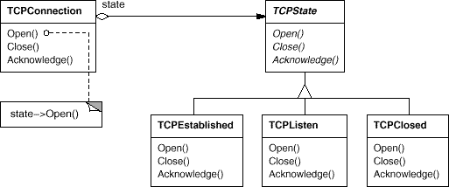
State
●
Example: TCP network connection
●
Behaviour of Open and Close methods may differ depending on the state of the connection (e.g. Established, Closed, etc.)
Note: this particular diagram uses older OMT syntax, not UML

Slide 72

State
Use state when:
an object's behaviour depends on its state, and it must change its behaviour at run-time depending on that state
operations have large, multipart conditional statements that depend on the object's state

Slide 73
State
●
Pros:
●
The responsibilities associated with each state are separated into different objects
●
Single Responsibility Principle
●
New states can be added without changing existing behaviour
●
Open/Closed Principle
●
Complex conditional logic can be replaced by simpler state transitions
●
Cons:
●
Can be overkill if only a few states are involved

Slide 74

Strategy Pattern

Slide 75
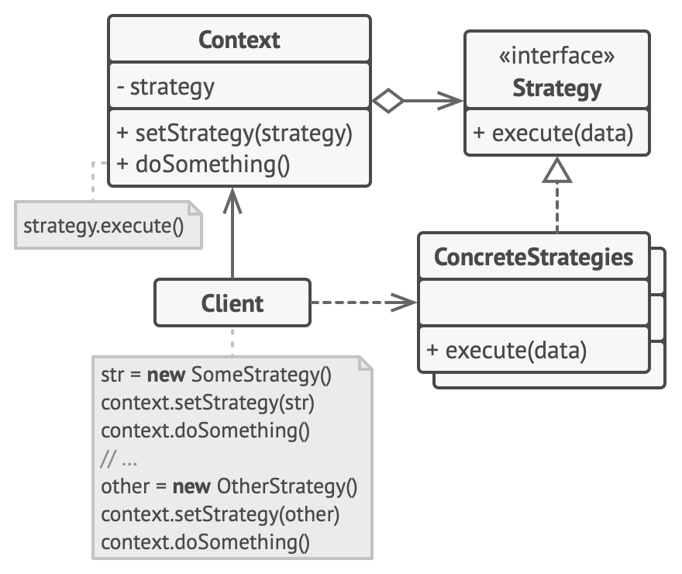
Strategy
●
The strategy pattern, also called the policy pattern, allows for a family of algorithms to be encapsulated as objects and be used interchangeably, decoupling the algorithm from the client code that uses it

Slide 76
Strategy
●
Strategy – defines an interface to be used by the family of algorithms
ConcreteStrategy – implements the Strategy interface, representing a single algorithm in the family
Context – maintains a reference to a Strategy implementation
●
●

Slide 77
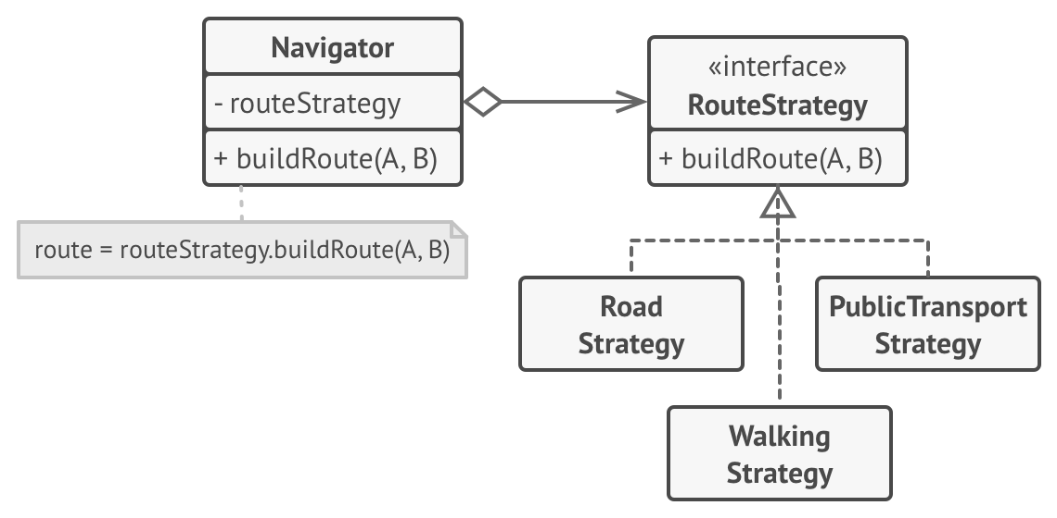
Strategy
●
Example: navigation app, with multiple types of route based on transportation options

Slide 78
Strategy
●
Use strategy when:
many related classes differ only in their behavior you need different variants of an algorithm
an algorithm uses data that clients shouldn't know about
a class defines many behaviors, and these appear as multiple conditional statements in its operations
●
●
●
●

Slide 79
Strategy
●
Pros:
●
Allows for choice of algorithm to be swapped at runtime without complex conditional logic
You can isolate the implementation details of an algorithm from the code that uses it New strategies can be introduced without breaking existing code
●
●
●
Open/Closed Principle
●
Cons:
Can be overkill when the choice of algorithms is limited and they don’t vary much
Most programming languages can use features such as anonymous functions to achieve the same pros without bloating the code with extra classes
●
●

Slide 80

Template Method

Slide 81
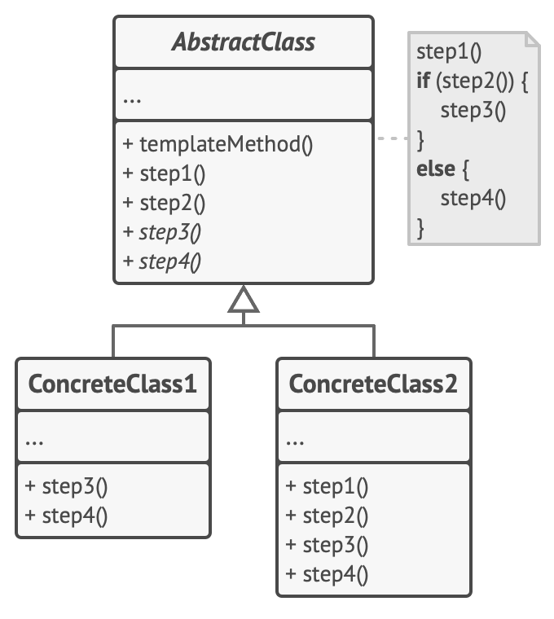
Template Method
●
The template method pattern allows for an algorithm skeleton to be defined in a superclass as a series of high-level steps, with the implementation of these steps defined in subclasses

Slide 82
Template Method
●
AbstractClass – defines a number of steps (primitive operations) that subclasses must implement, and a template method that executes these steps
ConcreteClass – implements the primitive operations defined by AbstractClass
●

Slide 83
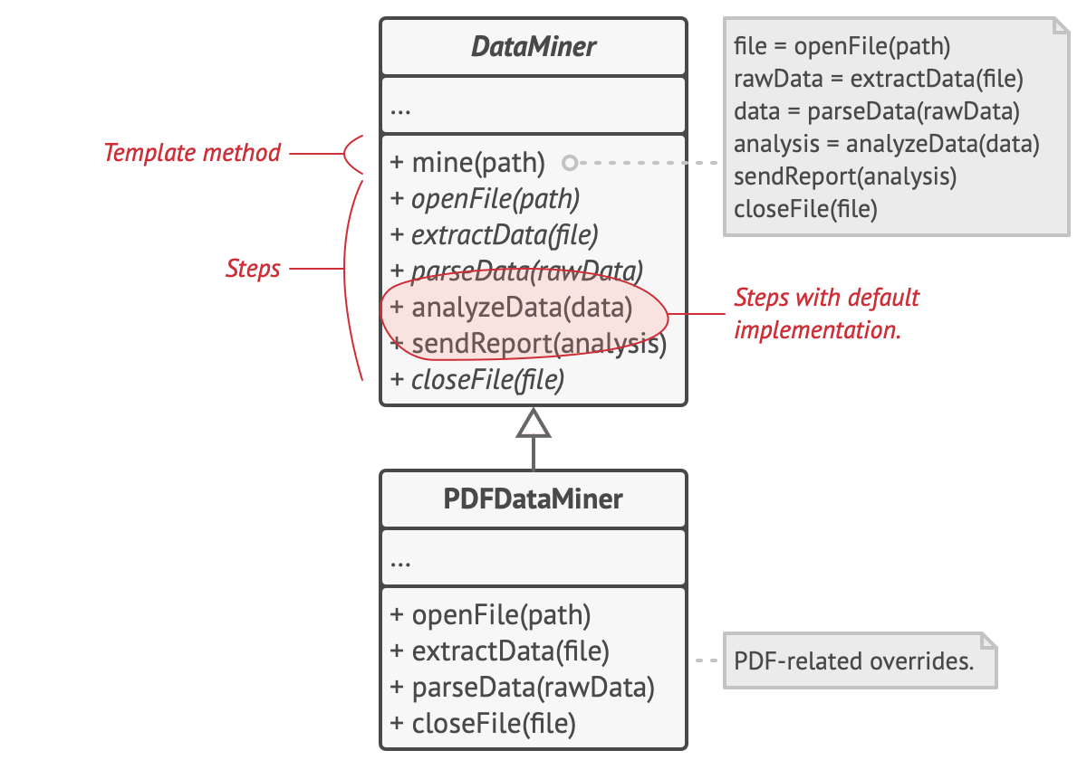
Template Method
●
Example: data mining application with separate algorithms for different file formats (e.g. pdf, csv, docs, etc.)

Slide 84

Template Method
Use template method when:
the basic steps for an algorithm never change, but the fine details of those steps may vary
clients should only be able to extend certain parts of an algorithm, not its entire structure

Slide 85
Template Method
●
Pros:
●
You can let clients override only certain parts of a large algorithm, making them less affected by changes that happen to other parts of the algorithm
You can pull the duplicate code into a superclass
●
●
Cons:
Some clients may be limited by the provided skeleton of an algorithm Template methods tend to be harder to maintain the more steps they have
●
●

Slide 86

Visitor Pattern

